Slide 1
Big Mountain Resort Ticket Price Analysis

Slide 2
Project Overview and Problem Statement
Big Mountain Resort, Montana, currently charges $81 per ticket to its ski resort
An additional ski lift was added this year which will add around $1.5 million in expenses.
Big Mountain traditionally sets ticket prices higher than other ski resorts in Montana because it has better features.
Problem Statement:
How can Big Mountain Resort adjust ticket prices to generate a minimum of $1,540,000 in an additional revenue during the upcoming ski season?

Slide 3
Recommendations and Key Findings
Big Mountain Resort modelled price is $93.48, while the actual price is $81.00. The model has a mean average error of $10.48
Through our model, we determined the variables that most effect a ski resort’s ticket prices. The top 4 are:
Vertical Drop
Number of Runs
Number of Chairs
Acres of Snow making
The top recommendation for cutting costs is to eliminate either exactly 1 ski run or exactly 5 ski runs.

Slide 4
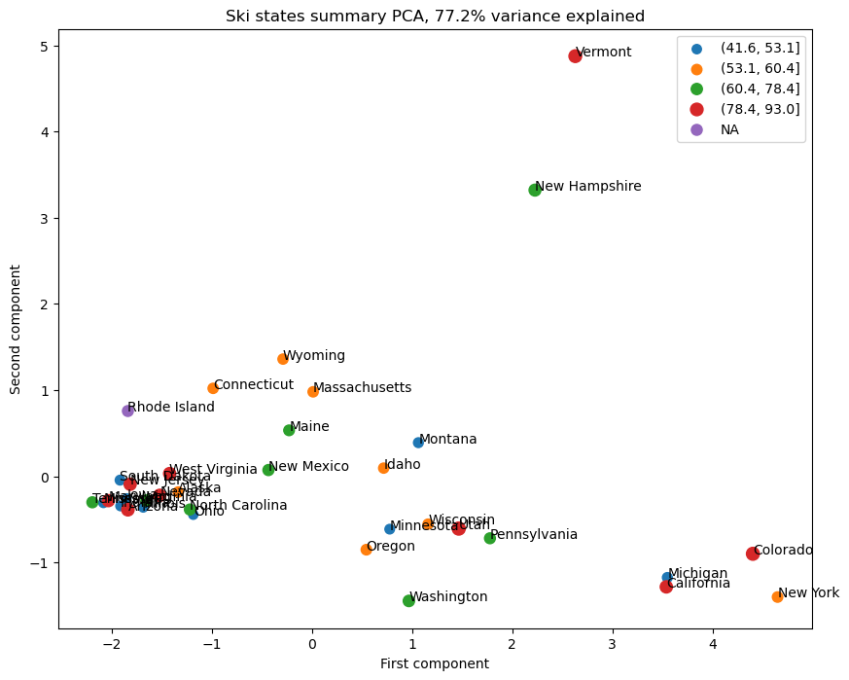
Modeling and Analysis
Key Analysis Question:
What are comparing Big Mountain’s ticket prices to: other Montana Resorts, Other regional resorts, or all resorts in the U.S.?
Our Answer:
Based on the graph to the right, no regional groups are apparent when running a PCA test. The market is a nationwide market and the state or region does not have a large impact on pricing.
All data will be used going forward to evaluate Big Mountain’s prices.

Slide 5
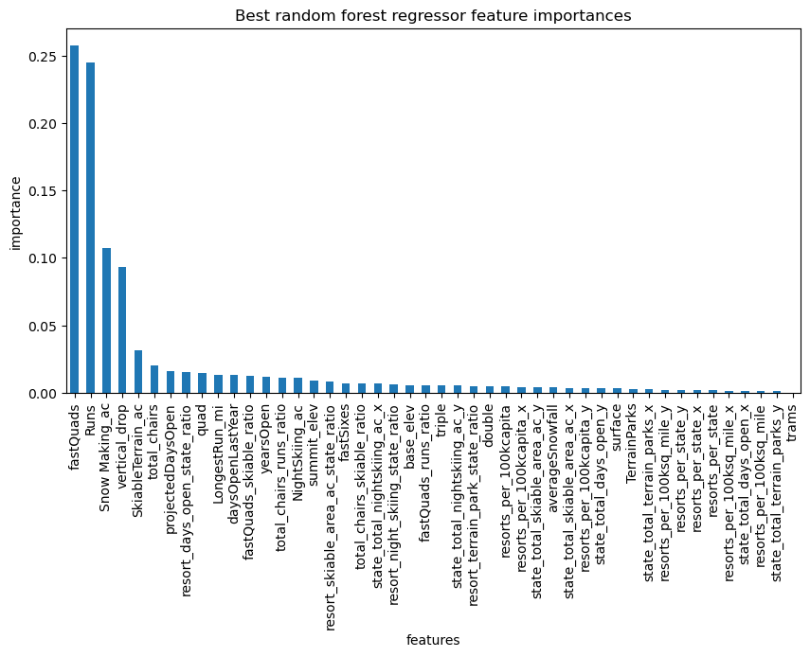
Modeling and Analysis
We created both a linear regression model and a random forest model to model ticket prices of all ski resorts around the country.
The graph to the right shows the most important features in determining the ticket price at ski resorts

Slide 6
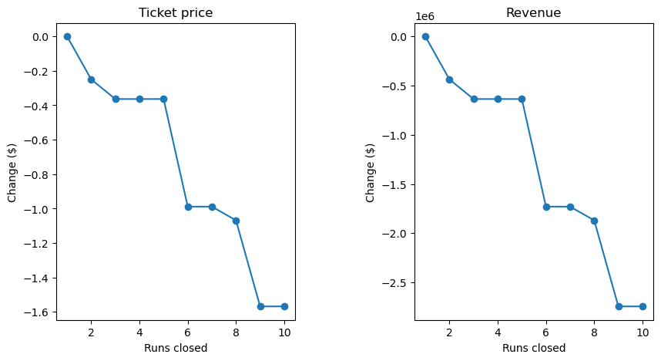
Modeling and Analysis:
Results
Big Mountain Resort modelled price is $93.48, actual price is $81.00.
Even with the expected mean absolute error of $10.40, this suggests there is room for a price increase.
The best way to cut costs is to close runs. As seen to the left, we recommend closing either 1 run or 5 runs.

Slide 7
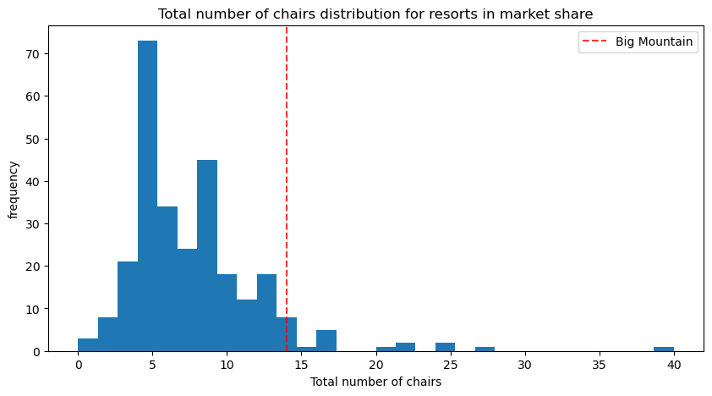
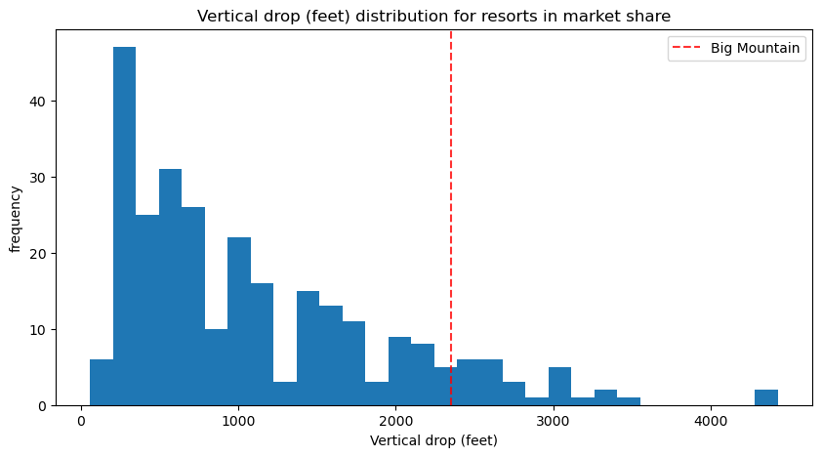
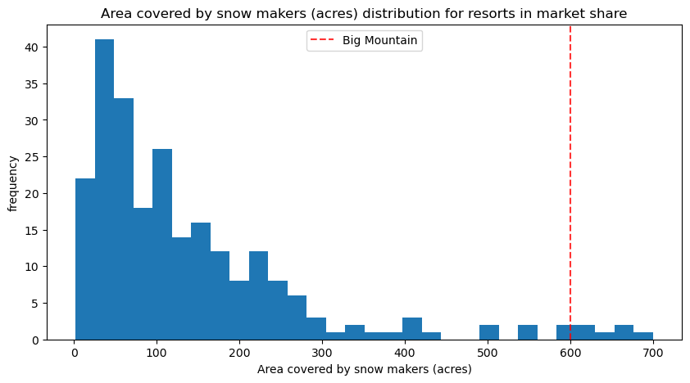
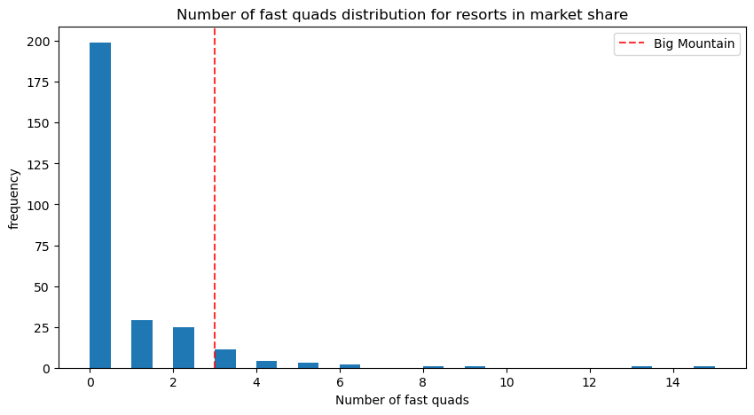
Conclusion
What Justifies the Price Increase?
Historically, Big Mountain has compared itself to other resorts in Montana and hasn’t wanted to price itself too high above competitors within the state. These graphs, however, paint a different picture; Big Mountain is a premier ski destination among its peers around the country and stands out in every category our model says is important in a customer’s willingness to pay. Big Mountain’s prices should reflect its exceptional features.

